Slide 1

Communication and Its Process.

Slide 2
MEANING
The word communication has been derived from the Latin word “ communicare” means ‘to share’.
Communication can be defined as exchange of facts, ideas, opinions or emotions of two or more person.
It is a process through which two or more persons exchange ideas to create better understanding.
Communication is completed when the receiver understands the message in the same sense that the communicator intends to convey.

Slide 3
DEFINITION
According to THEO HAIMANN
“ Communication means the process of passing information and understanding from one person to another.
According to the W.H NEWMAN and C.F SAUMMER
“ Communication is an exchange of facts, ideas, opinions or emotions by two or more person”
According to Aristotle
“ Communication is means of persuasion to influence others so that desired effect is achieved.

Slide 4

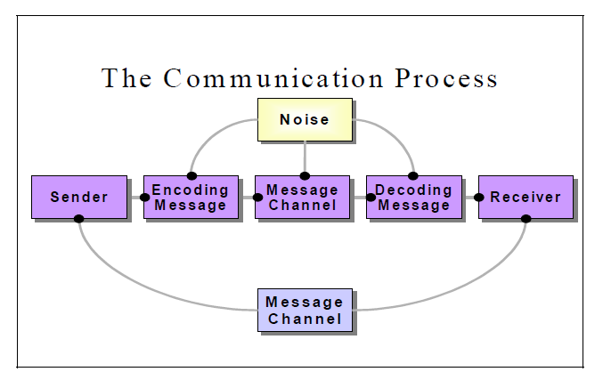

Slide 5
 Message
Message is a key idea that the sender wants to communicate. It is a sign that elicits the response of recipient. Communication process begins with deciding about the message to be conveyed. It must be ensured that the main objective of the message is clear.

Slide 6
COMPONENTS OF COMMUNICATION PROCESS
 Sender / Encoder
Sender / Encoder is a person who sends the message. A sender makes use of symbols (words or graphic or visual aids) to convey the message and produce the required response.
For instance - a training manager conducting training for new batch of employees. Sender may be an individual or a group or an organization. The views, background, approach, skills, competencies, and knowledge of the sender have a great impact on the message.

Slide 7

ENCODING
Encoding is the process where the information you would like to communicate gets transferred into a form to be sent and decoded by the receiver.

Slide 8
 Channel
Channels are the way you convey your message. These channels include verbal such as telephone, and face-to-face conversations as well as non-verbal such as picture and gesture. Each individual channel has its strengths and weaknesses in terms of communicating.

For instance - Written medium is chosen when a message has to be conveyed to a small group of people, while an oral medium is chosen when spontaneous feedback is required from the recipient as misunderstandings are cleared then and there.

Slide 9
DECODING
Decoding is on the receiving end of communication. This stage is just as important as encoding. Communication can go downhill at this stage if the receiver is not practicing active listening skills or if they do not possess enough information to accurately decode the message

Slide 10
 RECEIVER
Receiver is a person for whom the message is intended or aimed. The degree to which the decoder understands the message is dependent upon various factors such as knowledge of recipient, their responsiveness to the message, and the reliance of encoder on decoder.

Slide 11

FEEDBACK
Feedback is the main component of communication process as it permits the sender to analyze the efficacy of the message. It helps the sender in confirming the correct interpretation of message by the decoder. Feedback may be verbal (through words) or non-verbal (in form of smiles, sighs, etc.). It may take written form also in form of memos, reports, etc.

Slide 12
FEATURES OF COMMUNICATION
Existence of two parties
Two-way Process
Information Sharing and Understanding
Verbal and Non-Verbal.
Circular Flow.
Goal Oriented.
Continuous Process
Universal Process
Communication always exist.


Slide 13


